Slide 1
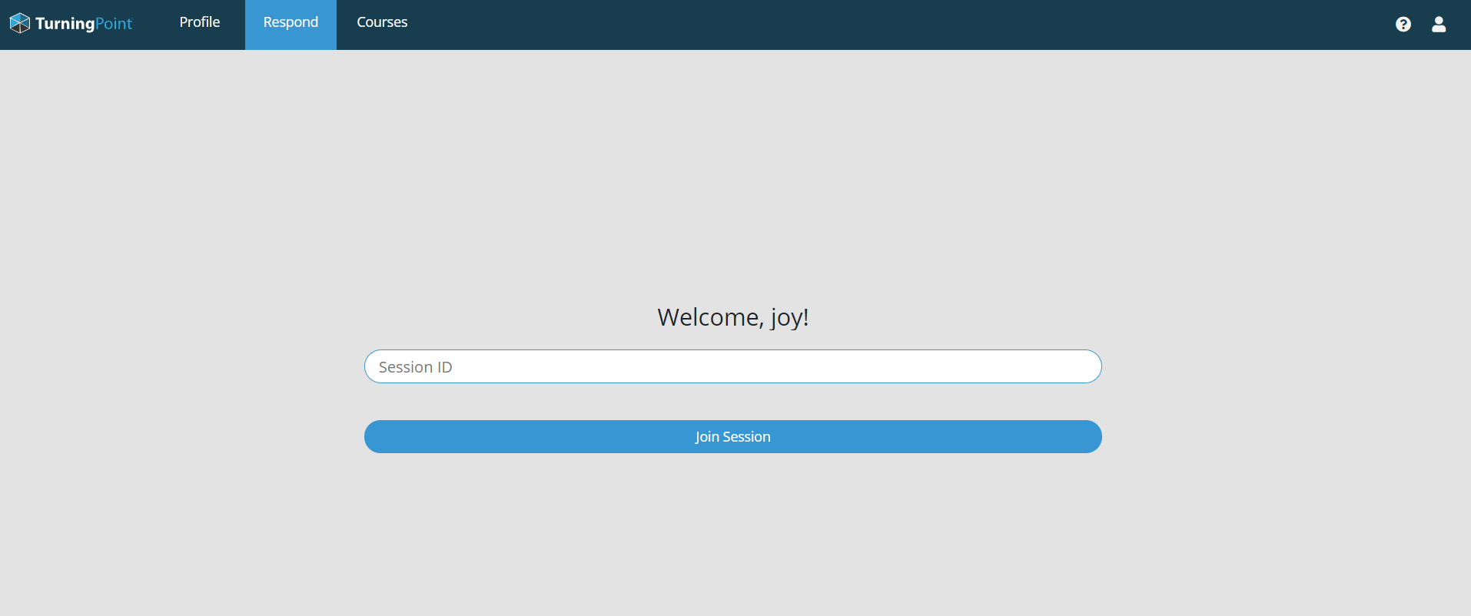
Turning Technologies
Connect your device to LSUHSC-Secure Wi-Fi.
Mobile Access:
Download the Turning Point App from App Store
Laptop Access:
Go to this site: https://student.turningtechnologies.com/
Sign in with your LSUHSC ID
If it prompts for a password use your LSUHSC password
Configure your profile by SKIPPING the following set-ups.
Subscription
Clicker ID
MOODLE
After skipping the three configuration settings, you should be redirected to your profile page.
Immediately click on “Respond” at top of page

